Slide 1
Blockchain and Cryptocurrency
CHAPTER ONE
ADAMA SCIENCE AND TECHNOLOGY UNIVERSITY
SoEEC – cse department – software engineering program

Slide 2
Blockchain
Blockchain is a shared, distributed and immutable ledger that facilitates the process of recording transactions and tracking assets in a peer-to-peer network.
In essence, it is a chain of blocks, where each block contains a list of transactions, a timestamp, and a reference to the previous block, forming a chronological and tamper-proof record of data.
Key Characteristics
Shared Distributed Ledger: Blockchain operates on a shared distributed ledger, where copies of the ledger are distributed across multiple nodes in the network. Each node maintains an identical copy of the ledger. Changes to the ledger are synchronized and propagated across the network through consensus mechanisms.
Immutability: Once a transaction is recorded on the blockchain and confirmed by consensus, it becomes virtually impossible to alter or delete. Each block contains a cryptographic hash of the previous block, creating a chain of blocks that is resistant to tampering and ensures the integrity of the entire transaction history.

Slide 3
Decentralization: Unlike traditional centralized systems where data is stored in a single location, blockchain operates on a decentralized network of computers (nodes). Each node maintains a copy of the blockchain, ensuring redundancy, fault tolerance, and resilience against single points of failure.
Append-Only: Blockchain is append-only, meaning that once data is added to the blockchain, it cannot be modified or deleted. New data is continuously added to the blockchain in the form of blocks.
Security: Blockchain employs cryptographic techniques such as hash functions, digital signatures, and consensus mechanisms to secure the network against fraud, manipulation, and unauthorized access.
Transparency: Transactions recorded on the blockchain are visible to all participants in the network. This transparency fosters trust and accountability, as anyone can verify the integrity and authenticity of transactions without relying on intermediaries.
Peer-to-Peer: Blockchain operates on a peer-to-peer (P2P) network, where transactions are directly conducted between participants without the need for intermediaries. P2P architecture enables direct interaction and communication between network participants, fostering decentralization and eliminating single points of control or failure.

Slide 4
The Block and The Chain
In simplest terms, blockchain uses a combination of cryptography and a public ledger to create trust between parties while maintaining privacy.
While blockchains can include many more features, the fundamentals of a blockchain are in the technology’s name:
The Block - A block is a list of transactions from a certain timeperiod. It contains all the information processed on the network within the past few minutes.
The Chain - Each block is timestamped, placed in chronological order, and linked to the block before it using cryptographic algorithms. These algorithms are difficult for computers to calculate and often take several minutes for the fastest computers in the world to solve. Once solved, the cryptographic chain locks the block into place, making it difficult to change.
The chain grows longer over time. Once a new block is created, the computers on the network work together to verify the transactions in the block and secure that block’s place in the chain.

Slide 5
Distributed Ledgers
The most fundamental part of the blockchain is the ledger. It’s where information about the accounts on the network is stored. The ledger inside the blockchain is what replaces the ledger at a bank or other institution.
A blockchain ledger is distributed across the network. Every node on the network keeps its own copy of the ledger and updates it when someone submits a new transaction.
Shared, distributed ledger — an immutable record of all transactions on the network, a record that all network participants can access. With a shared ledger, transactions are recorded only once, eliminating the duplication of effort that’s typical of traditional business networks.
The Bitcoin ledger, the first blockchain ledger, requires three pieces of information to list a transaction:
An Input - If Amy wants to send Ben a Bitcoin, she needs to tell the network where she got that Bitcoin in the first place. Maybe Amy received the Bitcoin yesterday from Sarah, so the first part of the ledger entry says so
An Amount - This is how much Amy wants to send to Ben;
An Output - This is Ben’s Bitcoin address where the Bitcoin should be deposited

Slide 6
Distributed Vs Centralized Vs Decentralized
In the field of computing, a distributed system is one where processing is not done solely on one computer. Rather, computation is shared across several computing resources. These systems communicate with one another using some form of messaging.
A distributed system has characteristics of decentralization, in that the failure of a single entity (or node) does not mean the failure of the whole network. The common goal is to use processing power to collectively accomplish a task by distributing responsibility across many computers. However, decentralization changes the concept of common goals and messaging.
In a fully decentralized system, a given node does not necessarily collabo‐ rate with every other node to achieve its objective, and decision-making is done through some form of consensus rather than having this responsibility rest in the hands of a single entity.

Slide 7
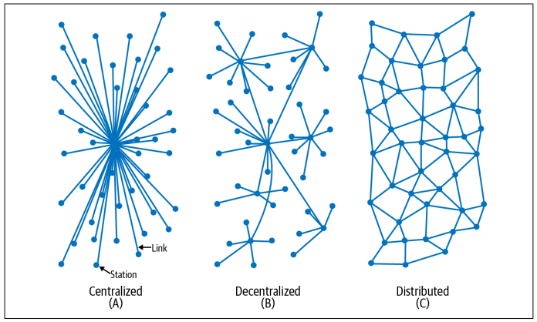

Slide 8
Distributed Vs Centralized Vs Decentralized
In a centralized database, like PayPal, all nodes connect to a single, central node that is controlled by one entity.
In a distributed database, like multiple databases hosted on Amazon Web Services (AWS), each node can maintain a replicated copy of the same data, each node knows the identity of other nodes, and all nodes are controlled by one entity.
In a decentralized database, like Bitcoin’s Blockchain, each node can main‐ tain a replicated copy of the same data, each node may not know the identify of other nodes, and all nodes are controlled by many entities who may be anonymous

Slide 9
Bitcoin
On August 18, 2008, >the domain bitcoin.org was registered. Then, written by some‐ one or a group using the pseudonym Satoshi Nakamoto, a whitepaper was published on October 31, 2008, and shared on numerous software developer mailing lists.
Titled “Bitcoin: A Peer-to-Peer Electronic Cash System,” the paper provided a detailed proposal for creating a value system that existed only on the internet.
The aim was to create a digital currency that could operate without any connection to a bank or central government, and to build a more transparent financial system that could prevent the catastrophic events of the 2008 financial crisis from ever happening again.
The Bitcoin proposal featured a number of ideas pulled from systems that preceded it. These included:
Secure digital transactions, like the smart contracts outlined by Nick Szabo
Using cryptography to secure transactions, like in DigiCash
The theoretical ability to send small amounts of secured value, as E-gold was able to do
The creation of money outside of governmental systems, as B-Money had proposed
Using proof-of-work to verify validity of digital funds, as Hashcash was designed to do

Slide 10
Bitcoin Whitepaper
The whitepaper also introduced several concepts that were new, including:
Double spending - The risk that a unit of currency is spent more than once via falsified duplication.
The Double Spend Problem, where an attacker could send you a token and then send someone else the same token a moment later. Double spend means that tokens could be spent multiple times, increasing inflation and devaluing the cryptocurrency.
Proof-of-work - A mathematical problem that must be solved using computational power.
Hashes - A fixed-length output is produced so that data of different sizes and sequences can be organized.
Nonces - A random number is used to ensure that a particular communication can only be used once.

Slide 11
Now comes a difficult-to-grasp concept: there is no such thing as a Bitcoin.
Of course, there are no physical Bitcoins. You probably already knew that.
However, there are also no Bitcoins on a hard drive somewhere.
You can’t point to a physical object, digital file, or piece of code and say, “this is a Bitcoin.” Instead, the entire Bitcoin network is only a series of transaction records.
Every transaction in the history of Bitcoin lives in the Bitcoin blockchain’s distributed ledger.
If you want to prove that you have 20 Bitcoins, the only way you can do it is by pointing to the transactions where you received those 20 Bitcoins.

Slide 12
Why Blockchain Ledger?
The idea dates back to 1991 proposed in a paper by Haber and Stornetta in 1991.
However, their proposal was a method for secure timestamping of digital documents, rather than a digital money scheme.
Timestamping: gives an approximate idea when a document came into existence. If the security property is satisfied, which is the timestamping can’t be changed after the fact, it accurately conveys the order of creation of these documents.
Pointer: it signs the document together with a link or a pointer to the previous document. It links to a piece of data instead of a location. That means that if the data in question changes, the pointer automatically become invalid.
These properties ensure the integrity of the contents of the previous document. Each block essentially fixes the entire history of documents and blocks up until that point.

Slide 13
Timestamp Server
In addition to using proof-of-work to secure the Bitcoin network, Satoshi proposed using a timestamp system to verify transactions, like filesystems and databases.
Taking the information generated during a transaction and running it through a hashing algorithm generates a fixed string of numbers and letters known as a hash.
For Bitcoin, Satoshi proposed using the SHA-256 algorithm that is popular in cryptography.
Here’s an example:
keccak256("hello") = 1c8aff950685c2ed4bc3174f3472287b56d9517b9c948127319a09a7a36deac8
Here that is again with one small change:
keccak256("hello1") = 57c65f1718e8297f4048beff2419e134656b7a856872b27ad77846e395f13ffe
Using a hash to store information is also key when preserving large amounts of information. As seen in this example, different inputs output a unique fixed-length string when hashed. This makes it easier to reference some stored piece of data that can be retrieved by a hash.

Slide 14
Opensource
Open-source software means it’s not proprietary—any developer can view the source code and modify it. In addition to being open source, cryptocurrency networks such as Bitcoin have three major components that make them uniquely attractive:
Value - A unit of account, called bitcoin (often denoted as BTC), is used to record trans‐ actions on the ledger, also known as the Bitcoin blockchain.
Distribution - As the Bitcoin whitepaper outlines, the Bitcoin network uses decentralized nodes in order to maintain a record of transactions.
Consensus - Miners in the Bitcoin network use proof-of-work together to maintain the security and stability of this distributed record of transactions.

Slide 15
Advantages and Disadvantages of Blockchain
Advantages:
1. Decentralization:
Blockchain operates on a decentralized network of computers, eliminating the need for a central authority. This enhances transparency and reduces the risk of a single point of failure.
2. Security:
Once a block is added to the chain, it is extremely challenging to alter previous blocks, ensuring the integrity of the entire blockchain.
3. Transparency:
All participants in a blockchain network have access to the same information, promoting transparency.
4. Immutability:
Once data is recorded on the blockchain, it cannot be altered or deleted.

Slide 16
Advantages:
5. Efficiency and Speed:
Blockchain eliminates intermediaries, reducing the time and complexity associated with traditional processes. Transactions can be processed quickly and efficiently.
6. Cost Reduction:
By removing intermediaries and streamlining processes, blockchain can lead to cost savings in various industries.
7. Smart Contracts:
Smart contracts are self-executing contracts with the terms of the agreement directly written into code. They automate and enforce contractual agreements, reducing the need for intermediaries.

Slide 17
Disadvantages:
1. Scalability:
As the size of the blockchain grows, scalability becomes a challenge. Transaction processing speed may decrease, affecting the overall efficiency.
2. Energy Consumption:
Some blockchain networks, particularly those using Proof of Work (PoW) consensus mechanisms, consume significant amounts of energy. This has raised concerns about the environmental impact.
3. Lack of Regulation:
The absence of clear regulations in many jurisdictions can lead to uncertainties and challenges, especially in legal and compliance matters.

Slide 18
Disadvantages:
4. Complexity:
Understanding and implementing blockchain technology can be complex for individuals and organizations. This complexity may hinder widespread adoption.
5. Limited Privacy:
While transactions are secure and transparent, the level of privacy is limited. Some blockchain networks struggle to find a balance between transparency and user privacy.
6. Interoperability:
Achieving interoperability between different blockchain networks and traditional systems is a challenge. This can hinder the seamless integration of blockchain into existing infrastructures.

Slide 19
Types of Blockchain
Different types of blockchains can be classified based on various viewpoints, including their accessibility, architecture, scalability solutions, and consensus mechanisms. Here's a classification based on these viewpoints:
Public vs. Private Blockchains
Public Blockchain: Accessible to anyone, public blockchains are decentralized networks where anyone can participate, view transactions, and validate blocks. Examples include Bitcoin and Ethereum.
Private Blockchain: Restricted access is granted to participants, typically controlled by a single organization or consortium. Private blockchains offer higher privacy and control but sacrifice decentralization. They are commonly used in enterprise settings for internal operations and consortium-based projects.

Slide 20
Public Blockchain
1. Accessibility - Public blockchains are open to anyone, and anyone can join the network, participate in the consensus process, and validate transactions. Examples include Bitcoin and Ethereum.
2. Decentralization - Public blockchains are typically decentralized, meaning no single entity or group has control over the entire network. The consensus mechanism is often designed to prevent concentration of power.
3. Permissionless - Public blockchains are permissionless, allowing anyone to read, write, and participate in the network without requiring approval.
4. Transparency - Transactions on public blockchains are transparent and visible to all participants.
5. Security - Security is maintained through cryptographic algorithms, consensus mechanisms, and the large number of participants. The openness of the network allows for a high level of security through decentralization.
6. Use Cases - Public blockchains are well-suited for applications where transparency, decentralization, and censorship resistance are essential, such as cryptocurrencies, decentralized finance (DeFi), and open-access projects.

Slide 21
Private Blockchain
1. Accessibility - Private blockchains are restricted to a specific group of participants. Access and participation in the network are controlled, often requiring permission from a central entity or administrator.
2. Centralization - Private blockchains are typically more centralized, with a designated entity or group having control over the network. This centralization allows for faster decision-making and coordination.
3. Permissioned - Private blockchains are permissioned, meaning participants need approval to join and participate in the network. This provides more control over who can contribute to the consensus process.
4. Privacy - Transactions on private blockchains are often more private, with restricted visibility. Participants may have limited access to the entire transaction history, enhancing confidentiality.
5. Security - Security is maintained through access controls, encryption, and the trust established among known participants. The centralization allows for easier coordination and enforcement of security measures.
6. Use Cases - Private blockchains are suitable for applications where a closed and controlled environment is required, such as within businesses, consortiums, or organizations. They are often used for supply chain management, internal record-keeping.

Slide 22

Proof of Work (PoW) vs. Proof of Stake (PoS)
Proof of Work (PoW): Consensus mechanism where miners compete to solve complex mathematical puzzles to validate transactions and create new blocks. PoW is energy-intensive but provides security and decentralization. Examples include Bitcoin.
Proof of Stake (PoS): Consensus mechanism where validators are chosen to create new blocks based on the amount of cryptocurrency they hold and are willing to "stake" as collateral. PoS is more energy-efficient but still provides security and decentralization. Examples include Ethereum and Cardano.

Slide 23
Proof of Work (PoW)
1. Consensus Mechanism:
In Proof of Work, participants compete to solve complex mathematical puzzles. The first one to solve the puzzle gets the right to add a new block to the blockchain and is rewarded with cryptocurrency.
2. Resource Intensive:
Mining in PoW is computationally intensive and requires substantial computing power.
3. Energy Consumption:
PoW systems, like the one used in Bitcoin, are known for their high energy consumption.
4. Security:
is considered highly secure because altering a block's information would require redoing all the work.

Slide 24
Proof of Stake (PoS)
1. Consensus Mechanism:
In Proof of Stake, validators are chosen to create a new block and verify transactions based on the amount of cryptocurrency they hold and are willing to "stake" as collateral.
2. Resource Intensive:
PoS is more resource-efficient compared to PoW since it doesn't require the same level of computational power. Validators are chosen based on their stake in the network.
3. Energy Consumption:
PoS is generally considered more environmentally friendly because it doesn't involve the energy-intensive mining process seen in PoW.
4. Security:
PoS relies on the economic incentive of validators not to cheat. Validators have something at stake (their cryptocurrency holdings), making malicious behavior economically irrational.

Slide 25
Other Types of Blockchains
Permissionless Blockchain: No restrictions on who can participate in the network, and anyone can join, transact, and validate blocks. It provides open access and decentralization. Examples include Bitcoin and Ethereum.
Permissioned Blockchain: Controlled access is granted to participants, requiring permission to join, transact, and validate blocks. It offers higher privacy, control, and efficiency but sacrifices decentralization. Examples include Hyperledger Fabric and Corda.
Federated (Consortium) Blockchain: are a type of private blockchain where multiple organizations or entities collaborate to control the network. Unlike fully private blockchains controlled by a single entity, federated blockchains involve a consortium of trusted members who jointly manage the network's operations and governance.
Hybrid Blockchain: Combines elements of both public and private blockchains, offering the flexibility to tailor access permissions and scalability solutions based on specific use cases. Hybrid blockchains can leverage the benefits of decentralization and control as needed.

Slide 26
Brief History of Blockchain
1991: Stuart Haber and W. Scott Stornetta propose a cryptographically secured chain of blocks to timestamp digital documents.
2008: Satoshi Nakamoto introduces Bitcoin in a whitepaper, combining existing concepts of cryptography and decentralization to create a peer-to-peer electronic cash system.
2009: Bitcoin software is released, marking the launch of the Bitcoin blockchain as the first implementation of blockchain technology.
2013: Vitalik Buterin proposes Ethereum, a blockchain platform with a built-in programming language enabling smart contracts and decentralized applications (DApps).
2015: Ethereum goes live, introducing a new era of blockchain technology beyond simple transactions.
2018: Initial Coin Offerings (ICOs) boom, Cryptocurrency market experiences significant volatility and regulatory scrutiny.
2020: Blockchain technology continues to mature, with increasing adoption across industries beyond finance, including supply chain management, healthcare, and voting systems.
Present: Blockchain technology evolves with advancements in scalability, interoperability, and sustainability, shaping the future of decentralized finance, Web3, and digital economies.

Slide 27
Layers of Blockchain Architecture
Blockchain architecture is the underlying structure and design of a blockchain network. It refers to the various components and layers that make up a blockchain and how they function together to enable the secure and transparent recording of transactions on a decentralized platform.
Application Layer - provides the user interface.
Middleware Layer - enables the integration of the blockchain with other systems.
Core Blockchain Layer - consists of the decentralized ledger and the consensus mechanism.
Network Layer - provides the underlying infrastructure for communication and data exchange.
Based on the above architecture, you can view the different types of technologies that power the entire Blockchain ecosystem as Layers 0 through 3.
Layer 0 - provides the underlying infrastructure such as the Internet.
Layer 1 - the decentralized ledger and the consensus mechanism maintained by a network of nodes.
Layer 2 - enables the integration of the blockchain with other systems to enhance scalability and performance without modifying the underlying protocol.
Layer 3 - provides the user interface such as web or mobile applications.

Slide 28
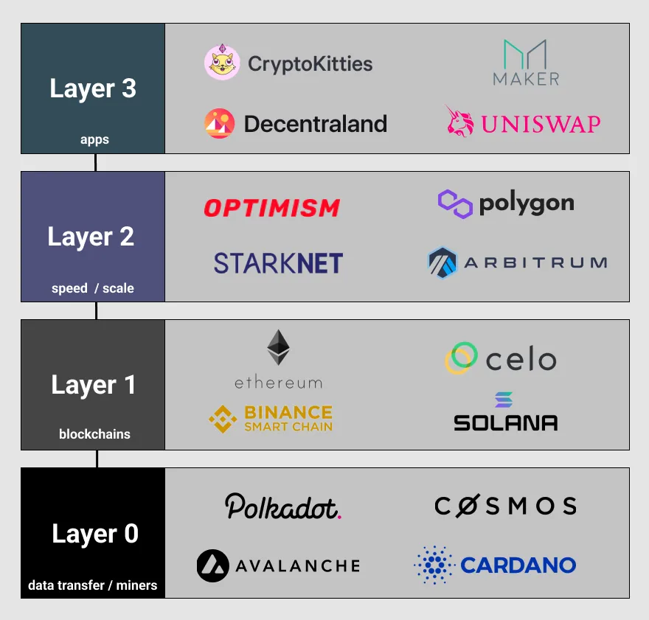
Layer 1 and Layer 2 crypto blockchain scaling solutions help increase the overall throughput—another name for processing speed of a blockchain network.
Layer 1 scaling includes updates to the block size, consensus mechanism, or database partition.
Layer 2 scaling includes bundling transactions, processing in parallel, or handling transactions off chain.
Layer 1 and Layer 2 scaling may compromise the security of a blockchain.

Slide 29
Challenges of the Blockchain
Scalability: As blockchain networks grow in size and transaction volume, they encounter limitations in processing capacity, leading to congestion and slower transaction times.
Interoperability: Blockchain interoperability refers to the ability of different blockchain networks to communicate and interact with each other seamlessly. Achieving interoperability requires developing common standards and protocols, which is a complex and ongoing effort.
Regulatory Uncertainty: Blockchain technology operates in a regulatory gray area in many jurisdictions, with regulations varying significantly across regions.
Privacy and Security: Public blockchains, in particular, expose transaction details to all network participants, raising concerns about data privacy and confidentiality. Additionally, securing blockchain networks from cyberattacks, fraud, and vulnerabilities requires robust security measures and best practices.
Energy Consumption: Some blockchain networks like Bitcoin, consume significant amounts of energy, leading to environmental concerns. Addressing the environmental impact of blockchain and transitioning to more energy-efficient consensus mechanisms, such as proof-of-stake (PoS), is crucial.
User Experience and Adoption: Blockchain technology can be complex and challenging for non-technical users to understand and use. Improving user experience, creating intuitive interfaces, and educating users about blockchain's benefits are essential for driving adoption and mainstream acceptance.
Governance and Consensus: Achieving consensus among network participants and maintaining decentralized governance structures can be challenging, leading to governance disputes and forks.

Slide 30
The Blockchain Trilemma
The Blockchain Trilemma refers to the difficulty in simultaneously achieving three key properties of blockchain systems: decentralization, security, and scalability.
It suggests that blockchain networks must navigate a three-way trade-off problem, where optimizing one or two properties inevitably comes at the expense of the third. Here's how each property relates to the trade-off problem:
Decentralization: Achieving high levels of decentralization often requires consensus mechanisms that involve all network participants, leading to slower transaction processing times and reduced scalability.
Security: Increasing security may require sacrificing decentralization or scalability, as stronger security measures may centralize control or impose limitations on transaction throughput.
Scalability: Scaling solutions, such as increasing block sizes or implementing off-chain transactions, can improve scalability but may compromise decentralization or security. For example, larger block sizes may increase centralization risks, while off-chain solutions may introduce security vulnerabilities.

Slide 31
Stakeholders or Participants of Blockchain
Blockchain Users: Users are individuals or entities that interact with the blockchain network by sending and receiving transactions, accessing decentralized applications (DApps), or participating in token economies. Users may include consumers, investors, developers, and businesses utilizing blockchain technology for various purposes.
Miners/Validators: Miners (in proof-of-work systems) or validators (in proof-of-stake systems) are responsible for verifying transactions, creating new blocks, and maintaining the integrity of the blockchain. They contribute computational power or stake cryptocurrency as collateral to participate in consensus mechanisms, such as mining or staking, and earn rewards for their contributions.
Developers: Developers are individuals or teams that design, build, and maintain blockchain protocols, applications, and smart contracts. They contribute to the innovation and evolution of blockchain technology by creating new features, improving scalability, and addressing security vulnerabilities.
Node Operators: Node operators run and maintain network nodes, which store a copy of the blockchain's ledger and validate transactions. Full nodes participate in the consensus process by verifying blocks and broadcasting transactions, contributing to network decentralization and resilience.
Governance Entities: Governance entities or organizations oversee the governance and decision-making processes within blockchain networks. They may include core development teams, foundation boards, or decentralized autonomous organizations (DAOs) responsible for proposing and implementing protocol upgrades, resolving disputes, and managing community initiatives.
Regulators and Policy Makers: Regulators and policy makers play a role in shaping the regulatory environment and legal framework surrounding blockchain technology. They establish regulations, guidelines, and compliance requirements to ensure consumer protection, prevent fraud, and promote innovation while mitigating risks associated with blockchain-based activities.

Slide 32
Terminology
Consensus Mechanisms: Consensus mechanisms are protocols used in blockchain networks to achieve agreement among network participants on the validity of transactions and the state of the ledger. Common consensus mechanisms include Proof of Work (PoW), Proof of Stake (PoS), Delegated Proof of Stake (DPoS), and Practical Byzantine Fault Tolerance (PBFT).
Smart Contracts: Smart contracts are self-executing contracts with predefined rules and conditions written in code. These contracts automatically enforce and execute the terms of an agreement between parties without the need for intermediaries, facilitating trustless transactions on blockchain networks.
DAOs (Decentralized Autonomous Organizations): DAOs are autonomous entities governed by smart contracts and run on blockchain networks. They enable decentralized decision-making and management of resources, allowing members to vote on proposals, allocate funds, and govern the organization's operations transparently and autonomously.
DApps (Decentralized Applications): DApps are applications built on blockchain networks that operate without a central authority or single point of control. They leverage smart contracts and decentralized protocols to enable peer-to-peer interactions, data transparency, and trustless transactions.
[THIS TOPICS WILL BE DISCUSSED IN DETAIL IN LATER CHAPTERS]

